Slide 1
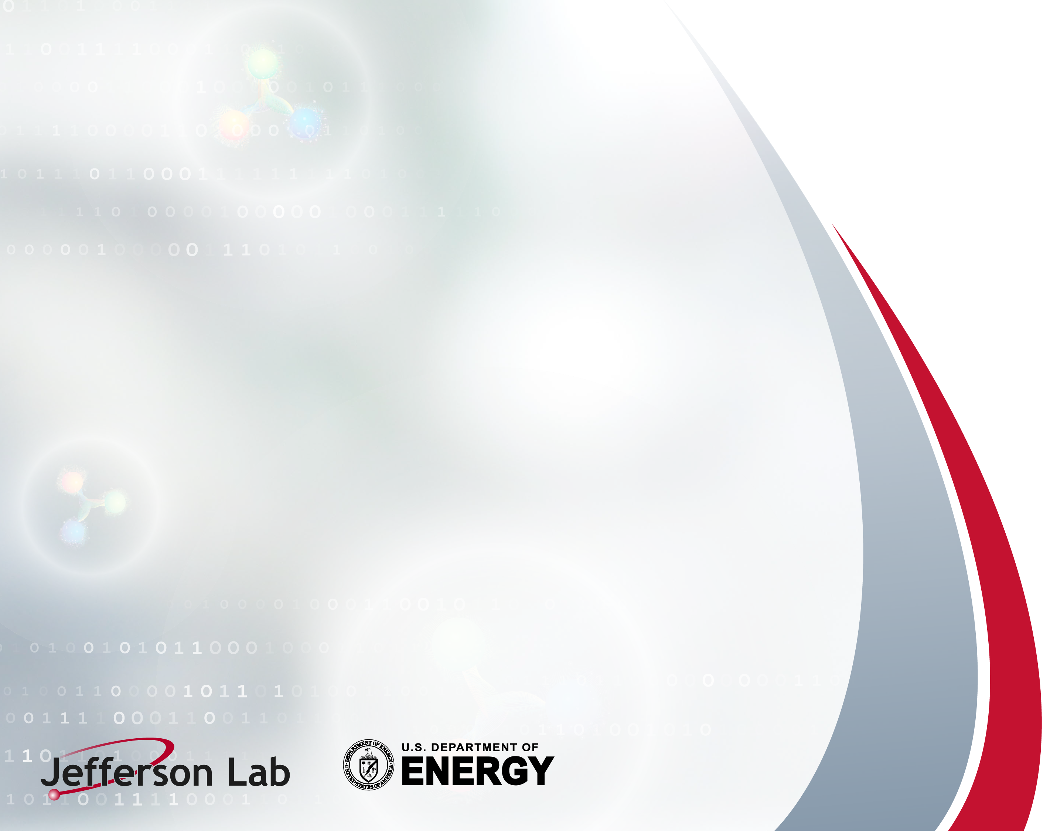
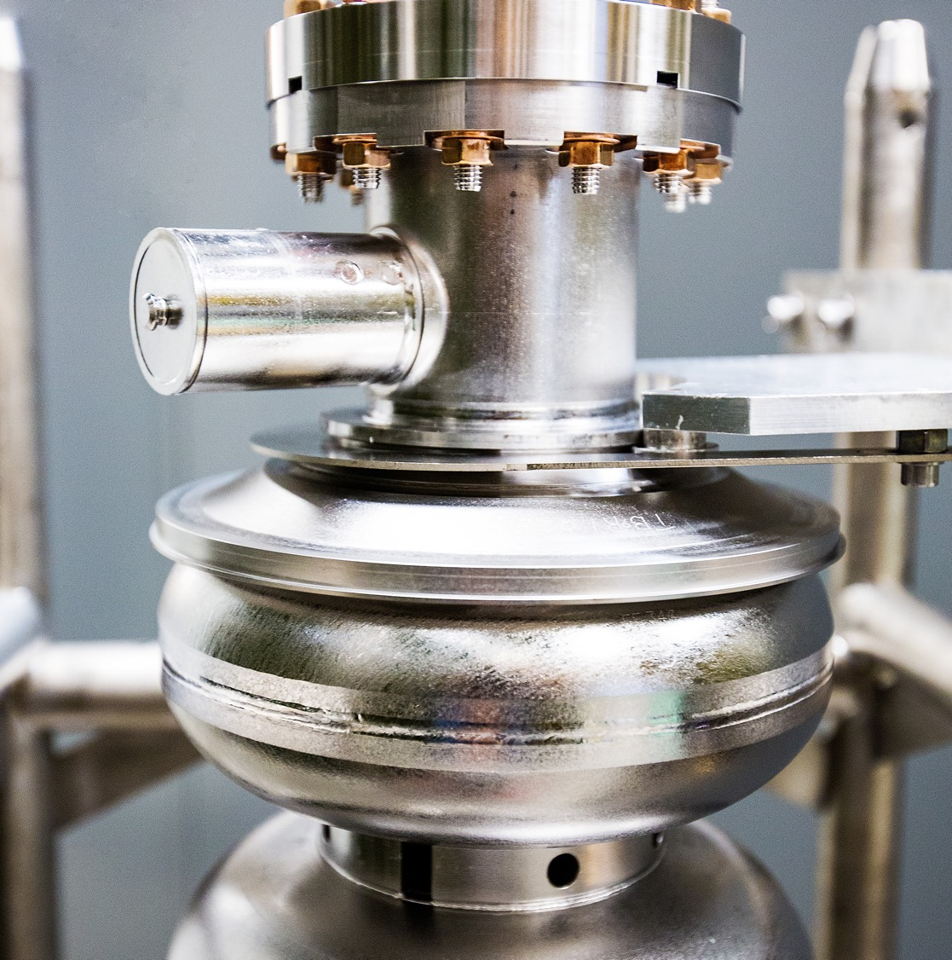
Exception Handling in SELAP
LLRF Workshop 2025
October 16th 2025
Rama Bachimanchi
Jefferson Lab
Notes:
Tip: Keep titles under 60 characters for readability
To change the photo: Right-click on photo and select change photo

Slide 2
Outline
Implementation timeline
GDR(IQ) Implementation
SELAP Implementation
Operational Aspects
Future work and conclusion
Notes:
Guidelines: 6-8 bullets per slide; Use sentence fragments for bullets
To change the photo: Right-click on photo and select change photo

Slide 3
Implementation Timeline
1978 J. Delayen, PhD thesis - locked analog SEL concept
2007 - Digital SEL and GDR(IQ) at JLAB
2014 L. Doolittle
2021/22 SELAP at JLAB
Notes:
Guidelines: 6-8 bullets per slide; Use sentence fragments for bullets
To change the photo: Right-click on photo and select change photo

Slide 4
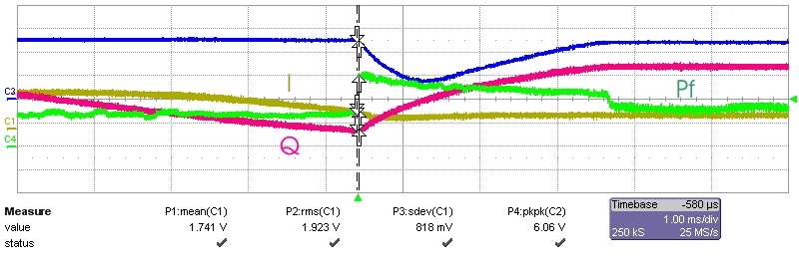
SEL and GDR (IQ) at JLAB
G_{mes}
Spinning phase (sinusoidal I&Q) while in SEL mode
Forward power spikes and G_{mes} droops as I&Q lock pulls the arbitrary I_{mes} & Q_{mes} to the set points
Power spiked 5 times (3/1.3)^2
Data taken from CMTF (2009)
LLRF 2.0 for C100 cryomodules
Qext – 7.5e6, Gradient 9 MV/m
I_{mes}
Forward Power
Q_{mes}
1 ms/div
Notes:
Guidelines: 6-8 bullets per slide; Use sentence fragments for bullets
To change the photo: Right-click on photo and select change photo

Slide 5
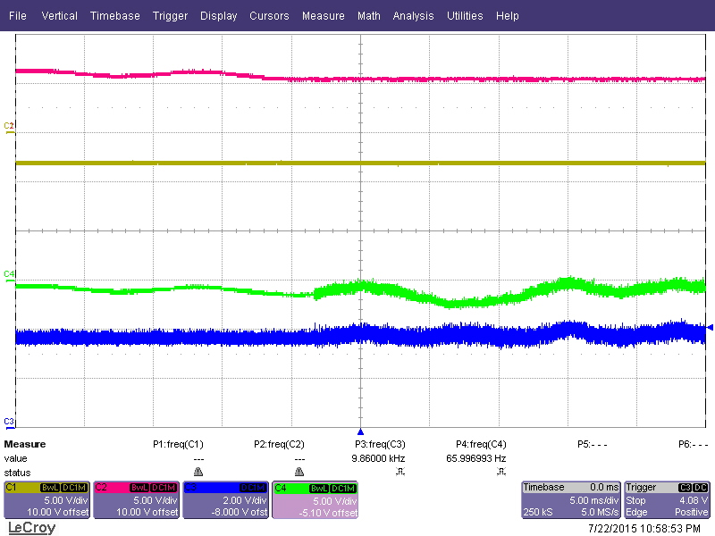
SEL to GDR(IQ) transition
After few firmware iterations in 2014
Firmware SELs until the spinning phase aligns with desired I&Q set points then switches to I&Q lock
Eliminates forward power spike and GMES droop
Smooth transition, no change in GMES or PMES
PMES
SEL Mode
GDR Mode
GMES
CRFPP (Forward Power Phase)
CRFP (Forward Power)
5 ms/div
Notes:
Guidelines: 6-8 bullets per slide; Use sentence fragments for bullets
To change the photo: Right-click on photo and select change photo

Slide 6
Limitations of the GDR(IQ) implementation
System operated well for the most part
Used it for operations on all C100 zones from 2011-2023
Still being used on one of the zones
Uses the full power and dac drive range
~40 % of the quenches were false quenches
From Tom Power’s data analysis
Couldn’t transition to GDR at higher gradients
Transition at lower gradients and ramp to the final set points
Recovery time was too long
No SELA mode to keep the gradient when cavity loses phase lock
AHDL code
No documentation
FPGA

Slide 7
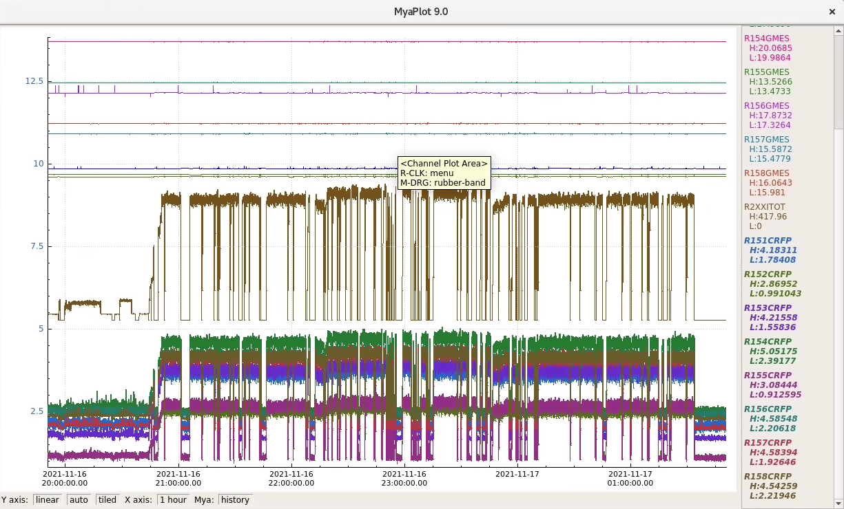
SELAP implementation from 2021
Based on LCLS-II implementation and discussions with Larry
VHDL implementation
This is GDR magnitude and phase (once locked)
Worked fine on one cavity in UITF
Booster Cryomodule
Tested with both 2.0 and 3.0 hardware
Installed the new 3.0 hardware and SELAP on a C75 cryomodule in summer of 2021
Worked fine for the most part
Beam loading ~410 uA
Klystrons – 8 kW
No auto recovery and trip waveforms at this point
Operational Experience with SELAP, LLRF 2022

Slide 8
SELAP implementation from 2022
Installed in 1L22
C100 cryomodule and LLRF 2.0
Looked fine while testing
Observed SEL poff drifts / variations frequently
Ran into similar issues as GDR (IQ) when locking phase
Transitioning from SELA from SELAP was not 100% reliable

Slide 9
Challenges of the SELAP implementation
Lot of unknown issues at this point
Worked well on a C75 cryomodule with LLRF 3.0
Not 100% reliable and unexplained faults on C100 cryomodule with LLRF 2.0
Where to set the limits?
RF TX
RF RX
FPGA

Slide 10
Operational aspects
Notes:
Use for: Introducing new topics
To change the photo: Right-click on photo and select change photo

Slide 11
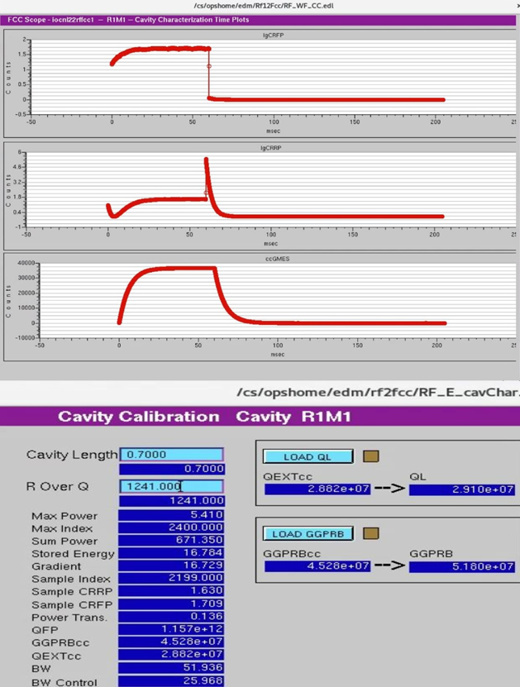
POFF (SEL loop phase) variations
Chassis were installed between 2011 and 2013
POFF fluctuations over time was a regular thing before 2023
SELAP is more sensitive to POFF
One of the RF technicians removed all the chassis in C100 zones and tightened all the connectors with a torque wrench in summer of 2023
Found lot of loose connections inside the chassis
Couldn’t make the energy in one of the linacs
Recalibrate all the gradients with in-situ cavity characterization
Brought the fudge closer to 1 in NL after this
Crate based designs have access to all the connectors
Pizza box designs have some connectors inside
How often should these be done??

Slide 12
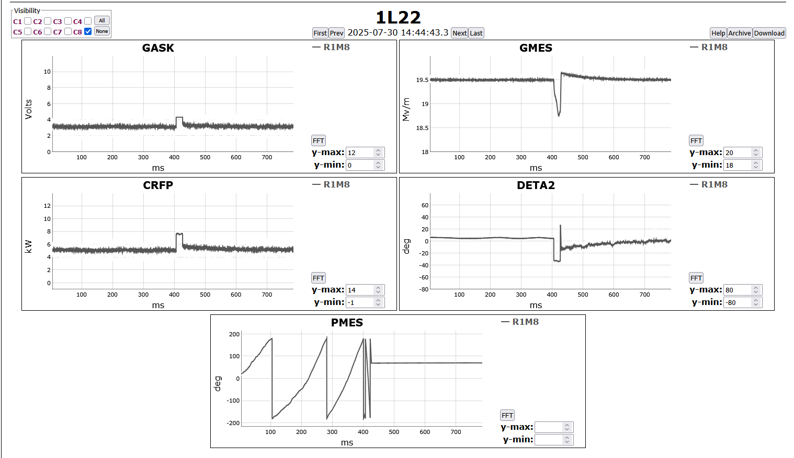
SELA to SELAP transition
SELA to SELAP transition
With detune allowance of 35 degrees
Forward power spike and gradient droop
G_{mes}
I_{mes}
Q_{mes}
Forward Power

Slide 13
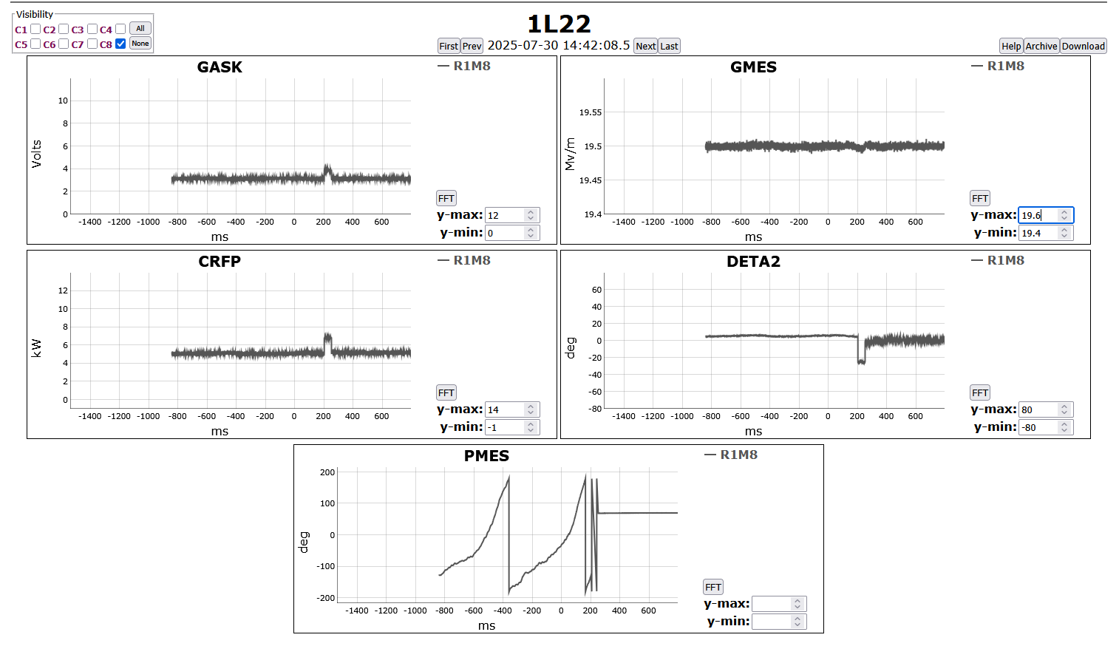
SELA to SELAP transition
SELA to SELAP transition
With detune allowance of 30 degrees
Forward power spike and gradient droop are smaller
SELA/SEL => PMES +/-180, PSET – static
Error => DFQE (cavity detune frequency), not PSET-PMES
PSET-PMES may cause the power spike regardless of the detuning
May saturate the amplifier without the limits
Limits for transition are lower than operational limits
SELA to SELAP transition is 99% reliable

Slide 14
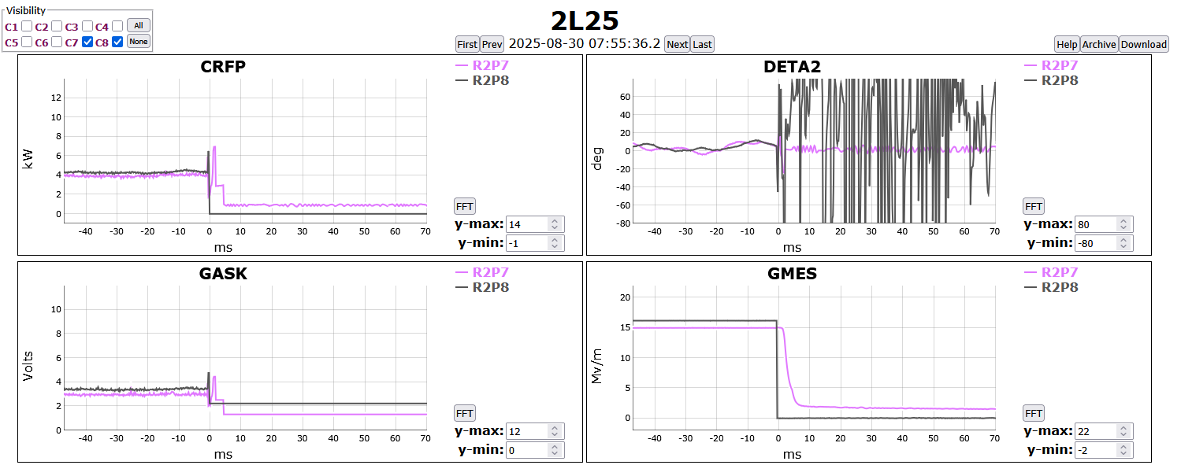
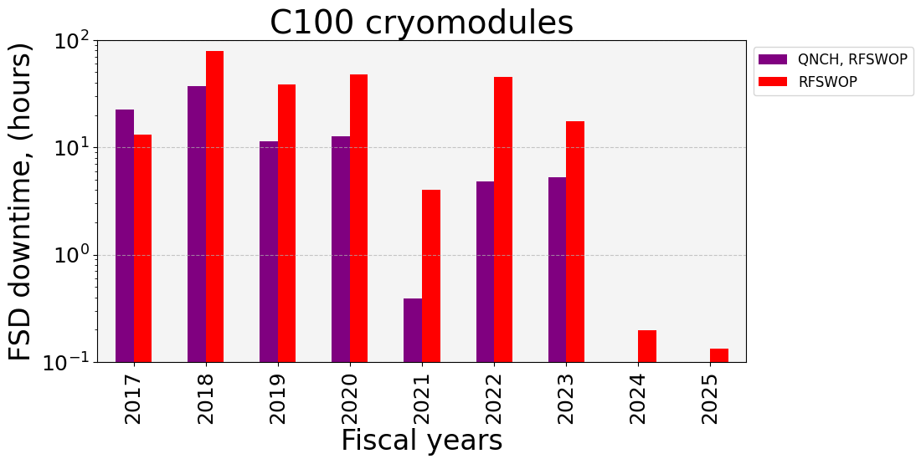
Quench Detection
dV/dt using cavity time constant
Cavity time constant is for power
For voltage (GMES) it should be twice
E = E₀*e^{-t/2τ}
τ = cavity time constant
There was an extra filter
dV and dt are adjustable in EPICS
Slightly modified the signal processing
~40% false quenches in the past
<5% now
Courtesy : Oleksander Hryhorenko

Slide 15
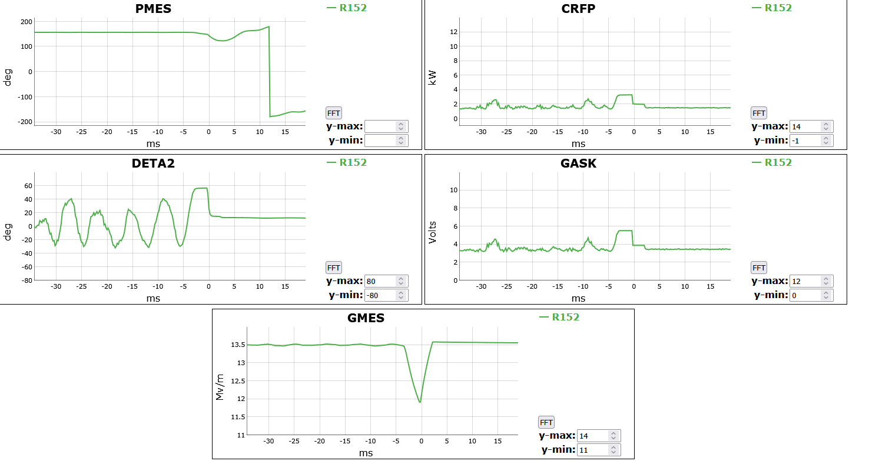
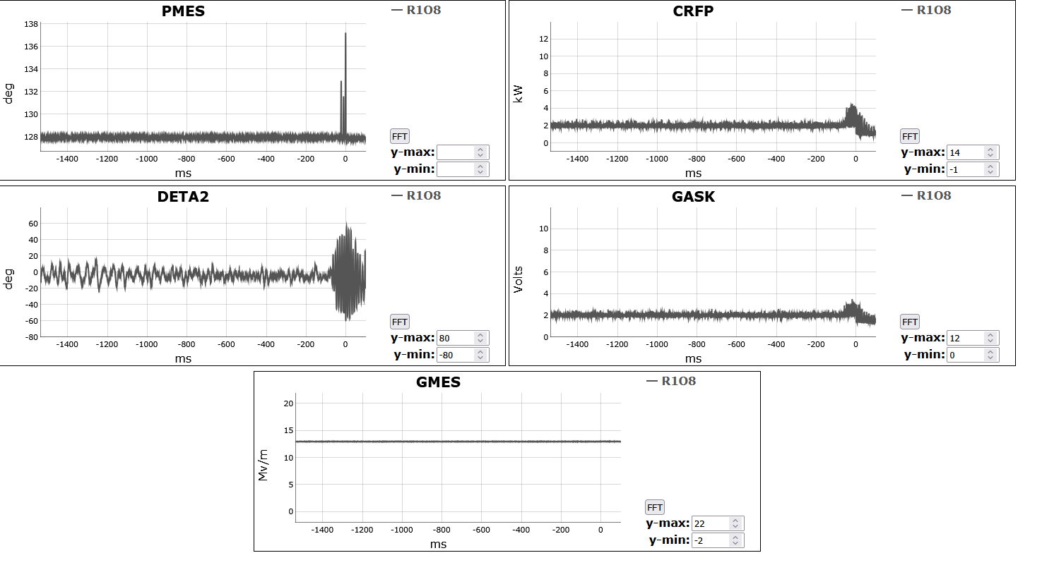
Beam FSD (MPS) and loss of Gradient/Phase regulation
Tom pointed this looking at the fault waveforms (from fall 2022)
Control system wasn’t pulling fast shut down for MPS at the right time
Not used in GDR(IQ) firmware
Not used in Analog system
Acquired waveforms on every beam trip
Looked at the machine tolerance to energy variation
~ 1 MeV for 5 pass (0.2 MeV)
GLDE and PLDE are set up accordingly (fall of 2023)
Gradient and phase loop detector errors
Adjustable in EPICS

Slide 16
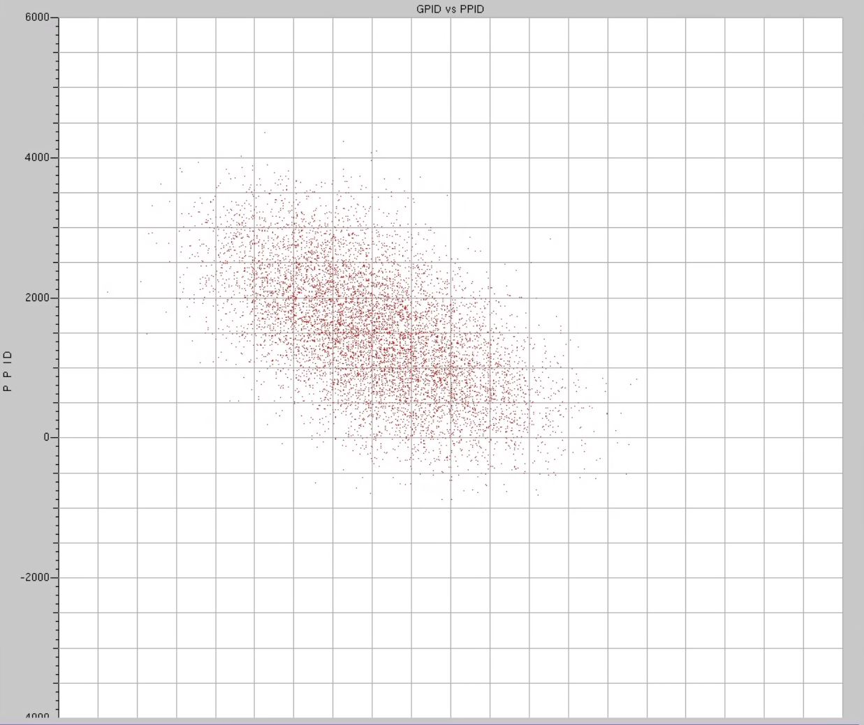
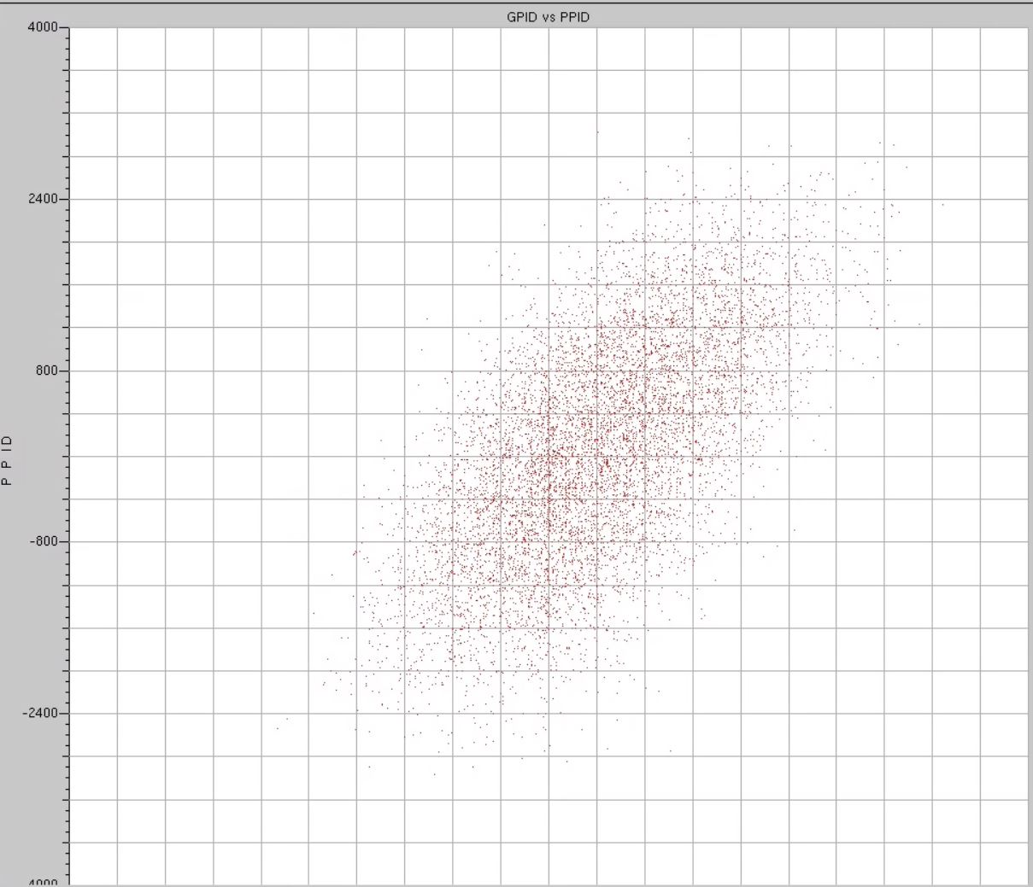
Drift/discrepancy in POFF
Cavities were faulting with 5 deg (or 10 deg) detuning
Reactive/detune allocated power was for 40 deg detuning
Discrepancy of poff between SEL and GDR/SELAP
It was in SEL/GDR(IQ) too
Don’t know the cause yet
Manually checking these based on the trips
Centering algorithm is being used at LCLS-II
Presented at 2023 LLRF workshop
Drift Observations and Mitigation in LCLS-II RF, Shreeharshini Murthy
Trips with 5, 10 deg DETA2 limit were minimized
POFF shift was minimizing the detuning allowance
Y drive
X drive

Slide 17
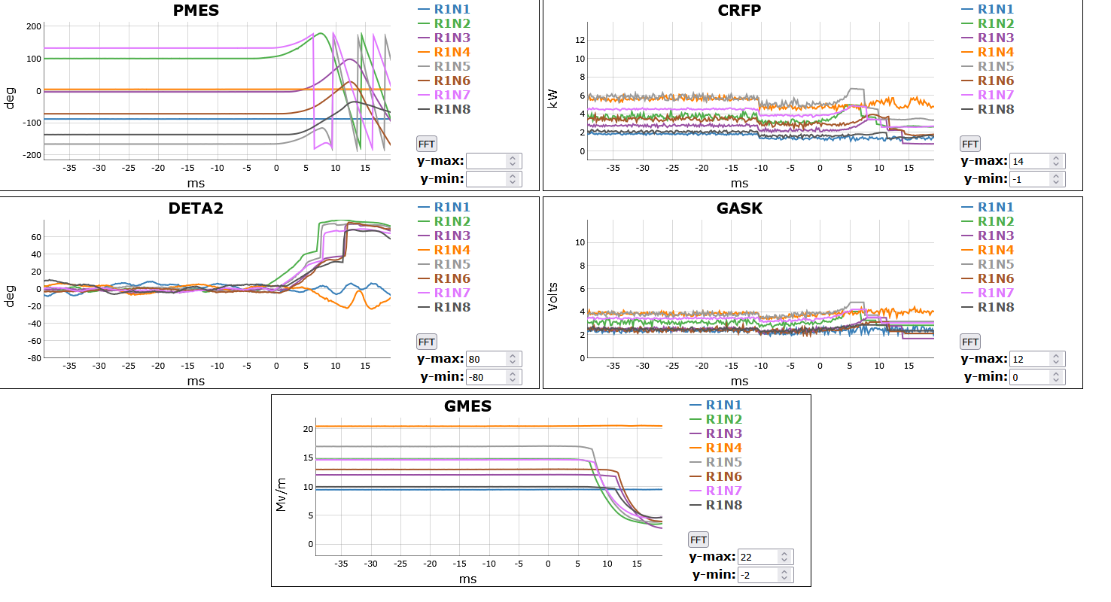
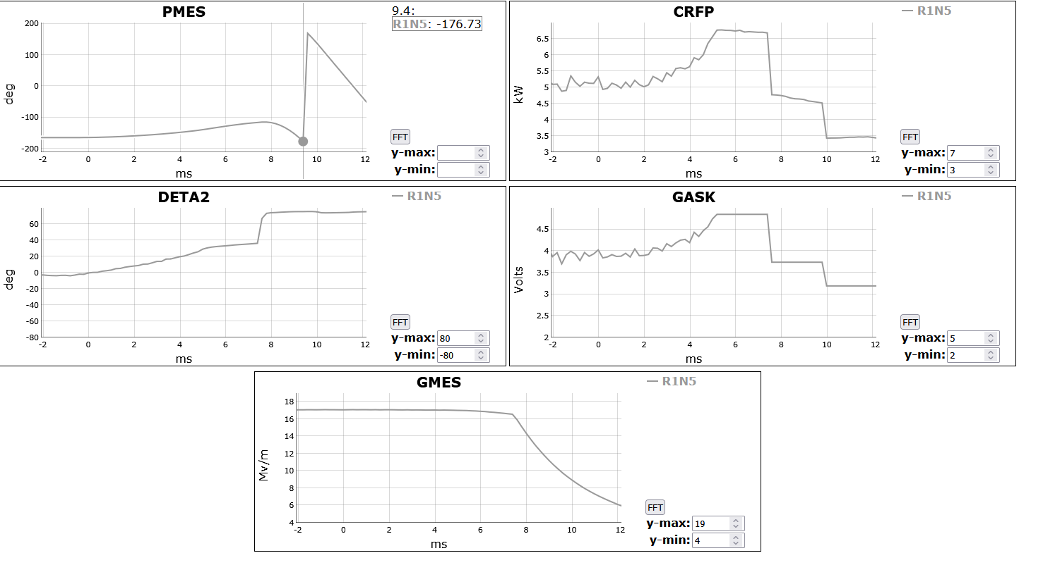
Transitioning between modes
Cavity bring up / recovery from a fault condition
SEL/SELA, detune < 5 Hz, lower reactive power limits
Transition to SELAP and install operational limits
Normal Operation
SELAP
Loss of phase regulation
Pull the beam fsd, stay in SELAP
Loss of amplitude regulation
Pull the beam fsd, transition to SELA
SELA
Loss of amplitude regulation
Transition to SEL (safe state)
SELAP
SELA
SEL

Slide 18
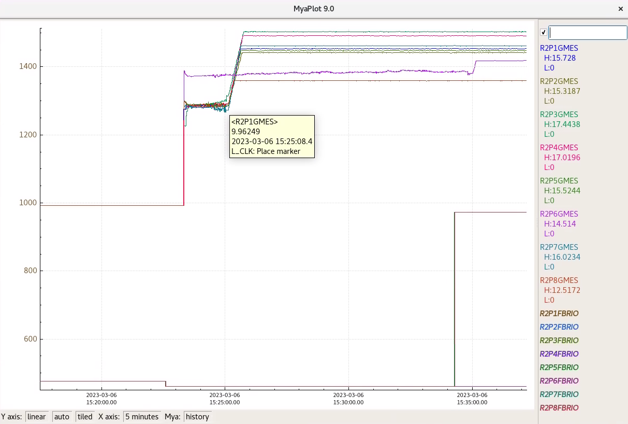
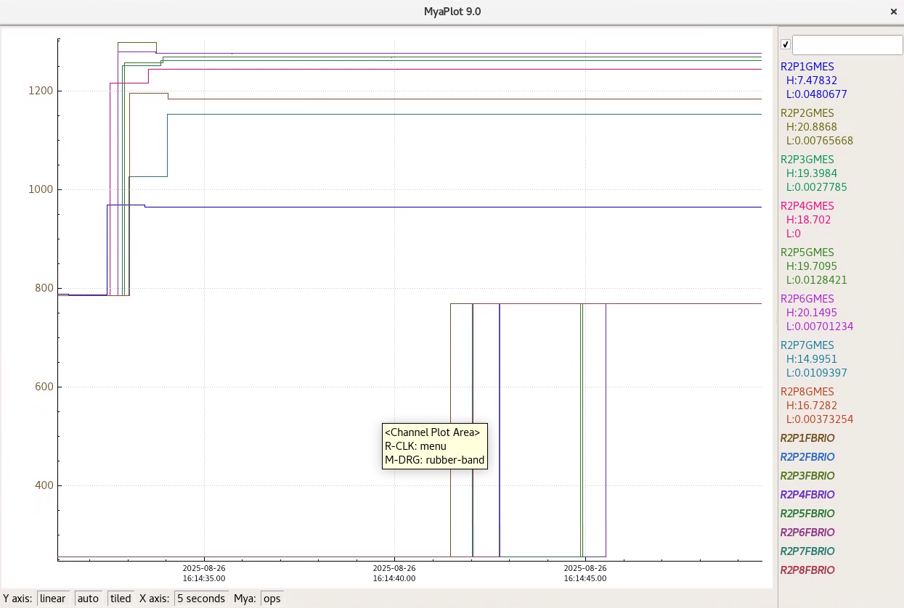
Recovery time comparison (2L25)
GDR (IQ)
Time scale 5 minutes
One of the first C100 modules
More microphonics
SELAP (GDRMP)
Time scale 5 seconds
Higher gradients

Slide 19
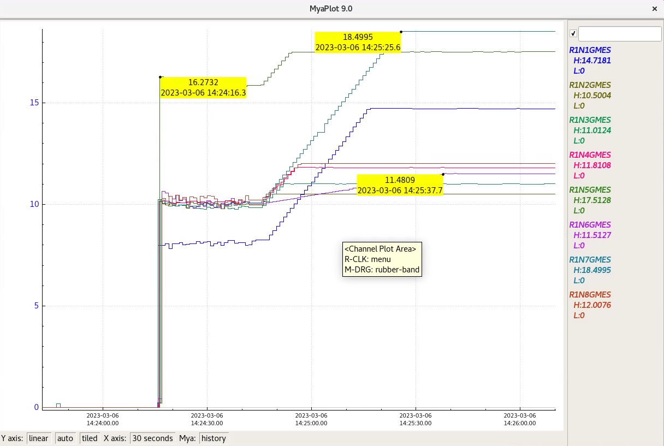
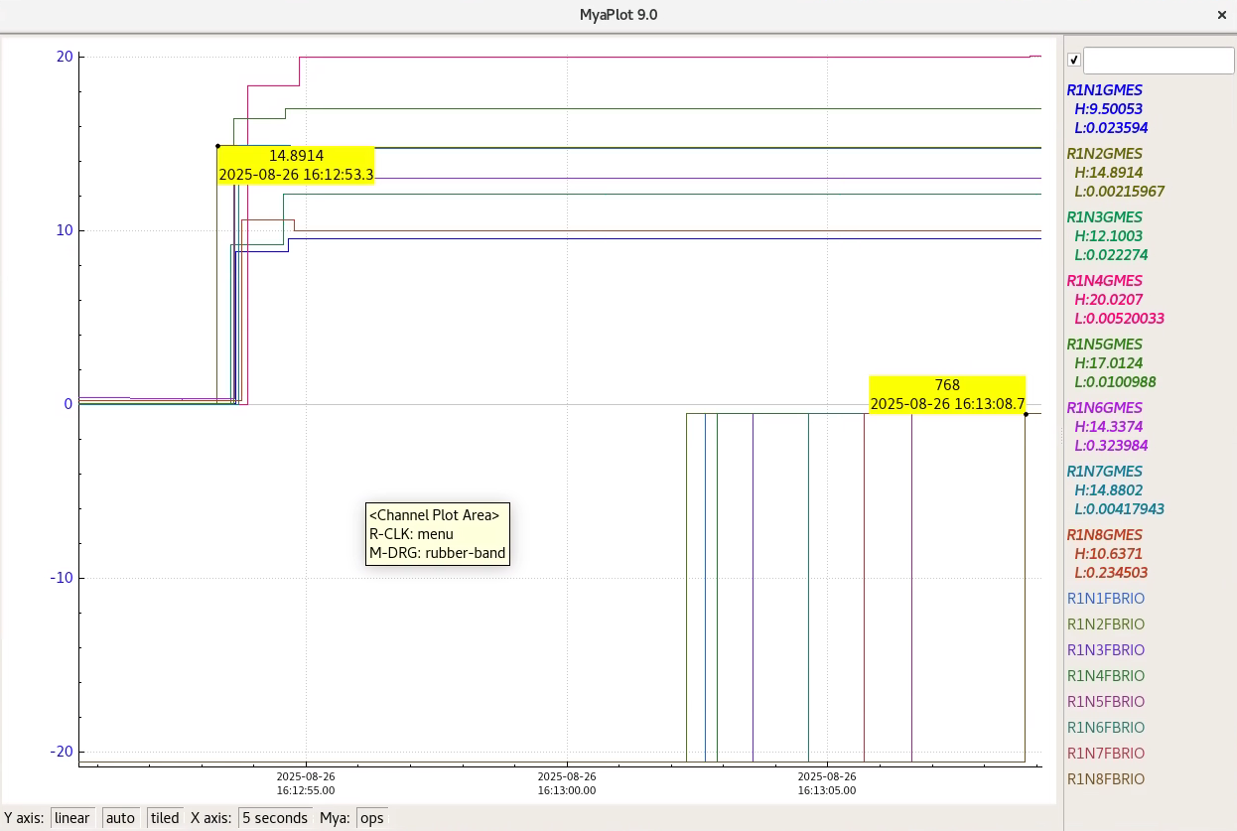
Recovery time comparison (1L23)
GDR (IQ)
Time scale 30 seconds
One of the prototype modules
Quiet module
SELAP (GDRMP)
Time scale 5 seconds
Higher gradients

Slide 20
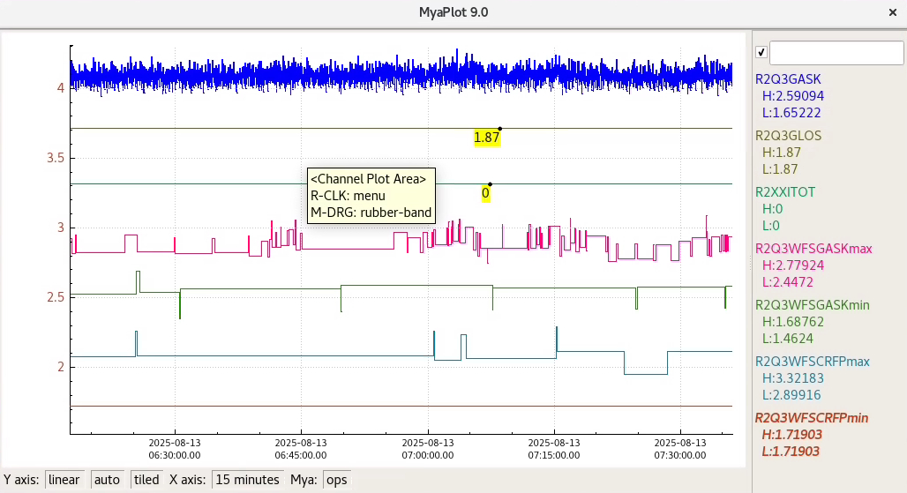
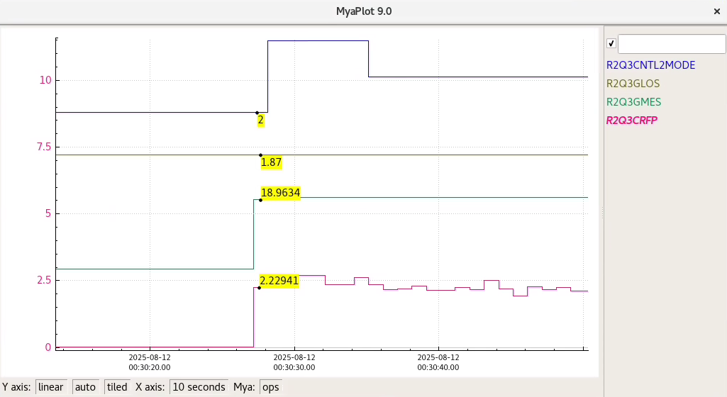
Unexplained Drive/Forward power noise
Been there since at least 2014
Plenty of instances from the machine
Independent of algorithm
Noise band increases with gain
SEL power 2.3 kW
SEL DAC drive 1.87 (normalized to 0 – 10V)
GDR/SELAP 1.7 kW to 3.32 kW
GDR/SELAP DAC drive 1.46 to 2.779

Slide 21
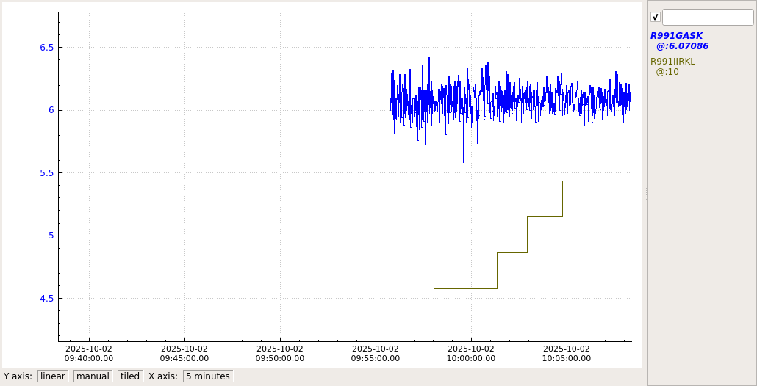
Test on the bench with cavity emulator
SEL was set up at DACdrv = 6
Why drive goes below 6?
Gets worse with more gain
Is the filter causing this?
3 dB BW is ~360 kHz
Spectrum got better when lowered the bandwidth
Need to do more testing
Different filtering scheme, if needed
FIR – 360 kHz (56 tap)
Added late 2013/early 2014
For suppressing 6/7 pi mode
IIRK 7/8 – 36/18 kHz
C100-1 and C100-2 were operated
Beam loading – 465uA
IIRK 8 – 18 kHz
IIRK 9 – 8.5 kHz
IIRK 10 – 4.4 kHz
FIR
IIRK 10
IIRK 9
IIRK 8
IIRK 7

Slide 22
Future Work
Notes:
Use for: Introducing new topics
To change the photo: Right-click on photo and select change photo

Slide 23
Future work
Opening limits all the way
Automate centering poff to track drifts
Different filtering scheme to reduce noise

Slide 24
Opening the limits all the way
Power allocated in two separate loops
Power not used by one loop is not available for the other
Doesn’t Maximize the klystron power usage
No limit for the gradient loop (Xdrv)
YLIM = √(DACdrvmax^{^2} – Xdrv^{^2}) – for phase loop
Use the limits for transition to SELAP
Open the limits once gradient and phase are stable
Engage the limits with gradient or phase regulation loss
This should Maximize the klystron power usage
Exception handling is critical
Klystron Phase compensation
Need to test

Slide 25
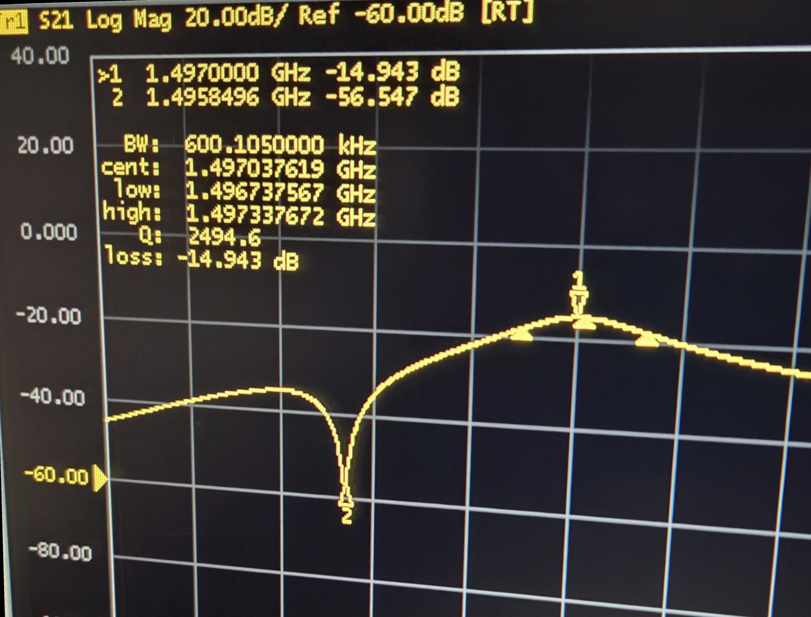
Low pass and Notch filter
Single pole IIR won’t suppress 6/7 pi mode enough
Implemented in VHDL based on Larry’s matlab code
Provides 40 – 50 dB suppression
Need to test it on a cavity
Adjustable in EPICS

Slide 26
Conclusion
SELAP gives you a well calibrated system
Fast recovery
Using amplifier power as the limit with exception handling in progress

Slide 27
Special Thanks to Larry Doolittle
Digitizer design
Based on Zest
FPGA board design
Dual LPC FMC with Cyclone 10GX
SELAP
Notch filter
Non – IQ sampling
And much more

Slide 28
THANK YOU
Notes:
Before sharing your presentation, confirm:
Fonts are consistent
Images meet quality standards
Charts use template colors
Footer information is current
Spell check completed
Links are working
File size is optimized

Slide 29
QUESTIONS?
Notes:
Before sharing your presentation, confirm:
Fonts are consistent
Images meet quality standards
Charts use template colors
Footer information is current
Spell check completed
Links are working
File size is optimized

Slide 30
SELAP implementation
Power requirements for the cavity
X_{power} – power required for gradient
P_{kly} = (L * E²/(4*Q_{ext}*r/Q))
X_{powerbeam}
P_{klybeam} = K_{powscale} * (L*(E+(I₀*Q_{ext}*r/Q)) ²/(4*Q_{ext}*r/Q))
Y_{power} – reactive power available for detuning
P_{klydf} = P_{kly} * tan(dA) * tan(dA)
Total power no beam = X_{powerbeam} + Y_{power} (I₀ = 0)
Total power with beam = X_{powerbeam} + Y_{power} (I₀ = beam current)
Resultant voltage vector for the power
Gradient Drive, Phase Drive

Slide 31
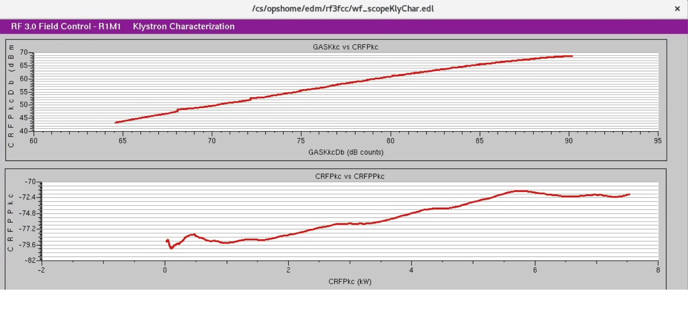
Klystron Characterization
Ramps the klystron input to max drive in 200 us
Cavity sees little to no gradient
Measures the klystron response to input drive
Phase response
Max power

Slide 32
Cavity Characterization
Cavity in pulse mode
Stored energy
Gradient (MV/m)
Q_{ext}
Bandwidth
Q_{FP} (field probe Q)
Can be calculated on every turn off event for CW or cavity decay for pulsed

Slide 33
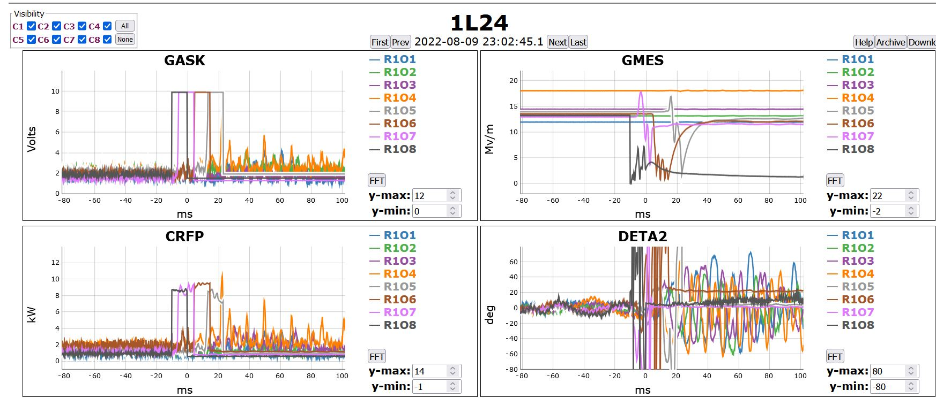
GDR VS SELAP with a cavity quench
GDR implementation
Example case
Cavity 8 quenched
Cavity fratricide
Other cavities went unstable
Klystron Power is the limit
Legend
GASK – Gradient Drive
GMES – Gradient measured
CRFP – Forward Power
DETA2 – Detune Angle

Slide 34
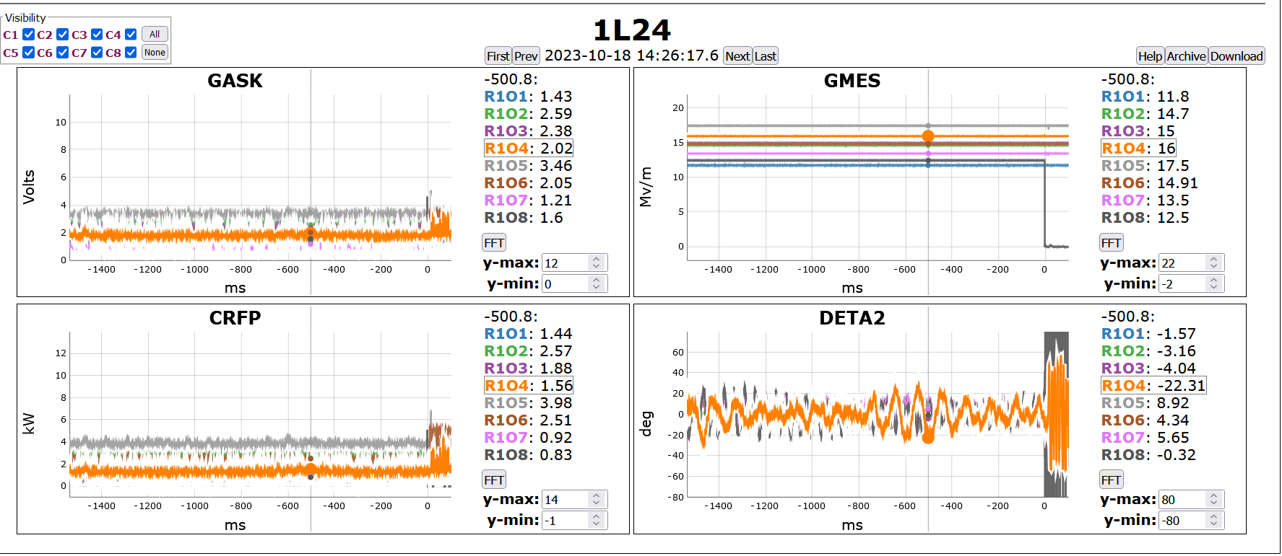
GDR VS SELAP with a cavity quench
SELAP implementation
Same Cavity 8 quenched
Other cavities stayed in SELA
Power limited in software
Legend
GASK – Gradient Drive
GMES – Gradient measured
CRFP – Forward Power
DETA2 – Detune Angle

Slide 35
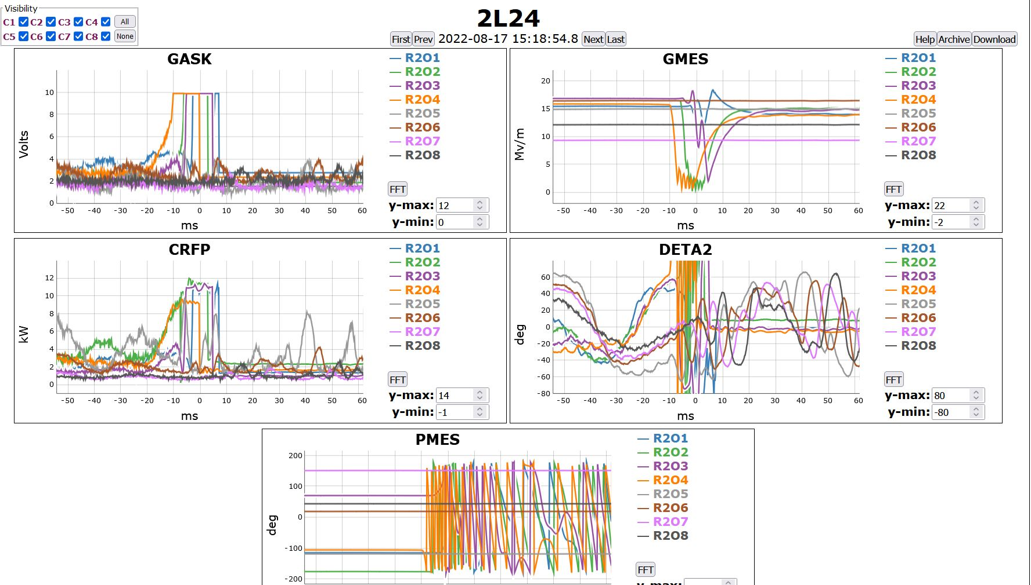
GDR VS SELAP with heavy detuning
GDR
Heavy detuning from microphonics
Multiple cavities lost regulation and switched to SEL
Legend
GASK – Gradient Drive
GMES – Gradient measured
CRFP – Forward Power
DETA2 – Detune Angle
PMES – cavity phase

Slide 36
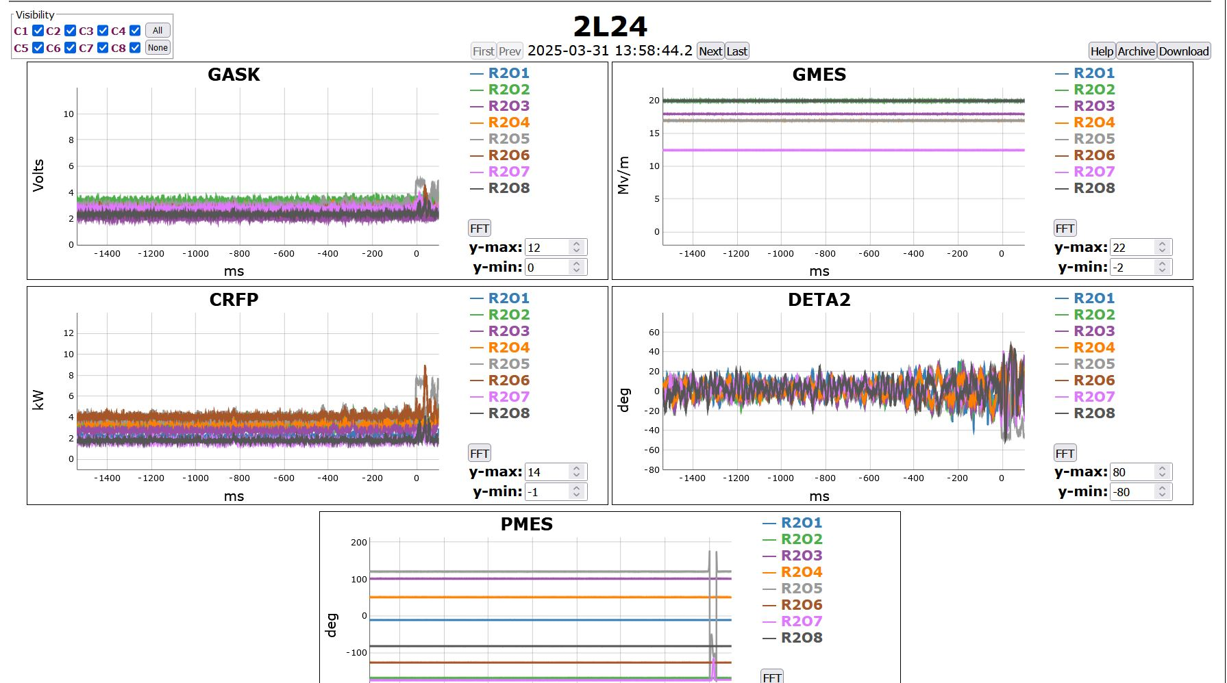
GDR VS SELAP with heavy detuning
SELAP
Heavy detuning from microphonics
All cavities stayed in SELAP
Two cavities lost phase regulation for few ms
Phase regulated after the transient
Legend
GASK – Gradient Drive
GMES – Gradient measured
CRFP – Forward Power
DETA2 – Detune Angle
PMES – cavity phase

Slide 37
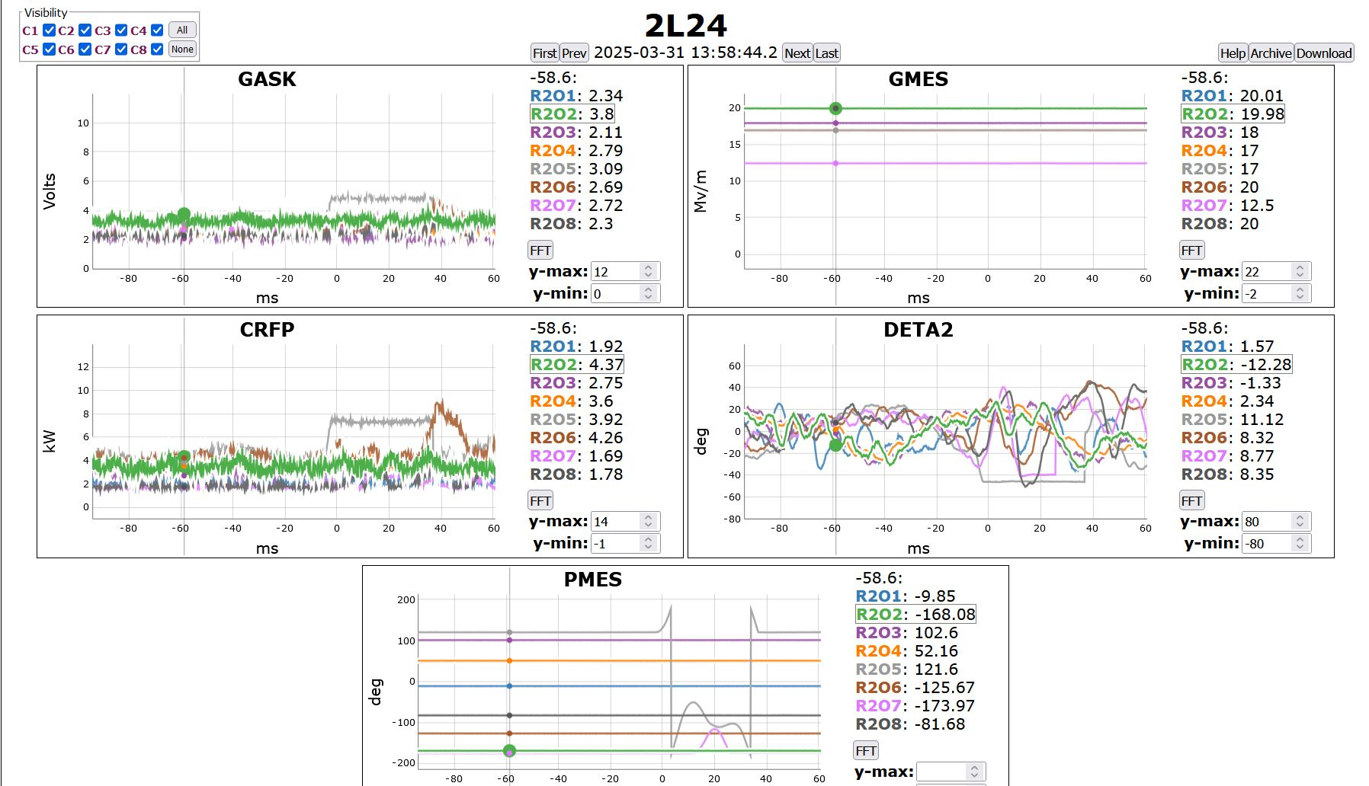
SELAP implementation
Cavities lose phase regulation when detuning exceeds the applied limit
Phase regulates once the detuning subsides
Faster recovery as cavity always maintains gradient and stays in SELAP
Trips beam when loses phase lock
SELAP is GDR alike when both amplitude and phase are locked

